Slide 1
GMOPN – Our Aims
To make sure that decisions made and work undertaken across Greater Manchester take into account the values and priorities of older people
To promote the significance of older people as vital members of communities and society
To make sure that older people from every borough of Greater Manchester have a chance to have their voices heard and have an influence.

Slide 2
GMOPN – Our Objectives
To draw attention to the diverse issues that affect older people within Greater Manchester, with particular focus on tackling social isolation and creating age-friendly neighbourhoods
To work with a wide range of organisations, the statutory sector and local and Greater Manchester Authorities to make sure that older people can influence policies, projects and services that affect them.
To make sure our network is inclusive and reflective of Greater Manchester’s diverse population and communities.
To promote a positive narrative about ageing and encourage others to do the same

Slide 3
GMOPN – Our Values
Being led by older people – the network ensures that older people take a leading role in the network, shaping its direction and priorities.
Being Age Proud – the network works to celebrate ageing and to emphasise the contributions that older people bring to our society.
Being representative and inclusive – encouraging the input of older people from all areas of Greater Manchester, from across the age range and representing all voices, including the most marginalised.

Slide 4
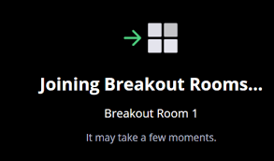
Breakout room 1 – introduced by Alison Littlewood
What is a breakout room?
Breakout rooms are sessions that are split off from the main Zoom meeting. They allow the participants to meet in smaller groups, and are completely isolated in terms of audio and video from the main session
How do I get into a breakout room?
Victoria will automatically set things up so you will join your breakout
room without having to do anything. At the end of the session you will
be brought back into the main Zoom meeting, again without having to
do anything.

Slide 5
Ground rules for breakout rooms
Only one person will speak at a time so that they can be heard by everyone and the person running the breakout room has a chance to get points written down.
Listen to one another.
Respect different opinions and experiences.
Try to keep your contributions relatively short so that everyone has a chance to speak and input.

Slide 6
Breakout room discussion and feedback
Who will be in the breakout room and how long will this section last?
There will be approximately 8 people in each room, which also includes two people who will be running the session. This session will last for around 15-20 minutes.
Discussion question:
What do you think the barriers to participating in research are?
What stops you getting involved?
How will we feedback our discussion to the group?
One of the people running the session will be taking notes during the discussion and will feedback the main key point afterwards. All points will be documented and will help the research team understand the barriers to involvement in research and help us think about solutions to increase participation.

Slide 7
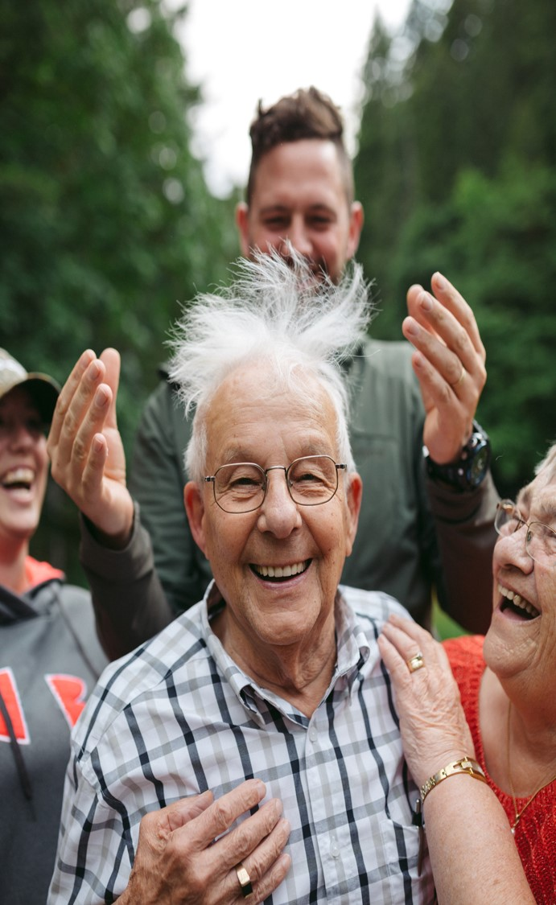
Professor Chris Todd
Healthy Ageing Research Group
Policy Research Unit Older People
Applied Research Collaboration GM
University of Manchester

Slide 8
Why do we do research?
To ensure health and social care is based on evidence
To make sure treatments work and are effective
To improve the health, well-being and lives of people living in our communities

Slide 9
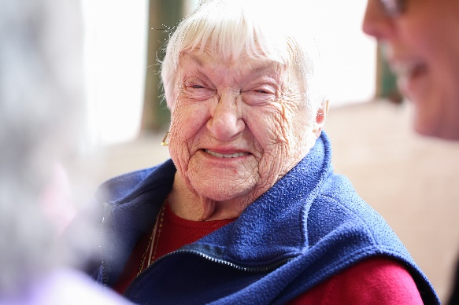
The Healthy Ageing Research Family
University of Manchester Healthy Ageing Research Group
National Institute for Health Research - Applied Research Collaboration (Healthy Ageing theme)
Manchester Institute for Collaborative Research on Ageing (MICRA)
National Institute for Health Research - Older People and Frailty Policy Research Unit

Slide 10
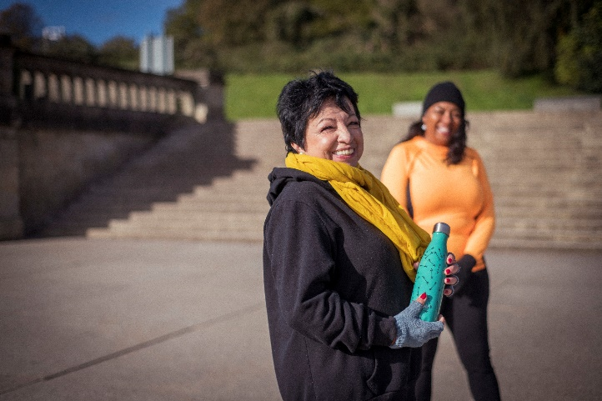
What sort of research do we do?
Falls and falls prevention
Physical activity and exercise
promotion (strength and balance)
Nutrition and diet
Rehabilitation and musculoskeletal conditions
Development of technologies to help people age well
Health behaviour change and health literacy

Slide 11
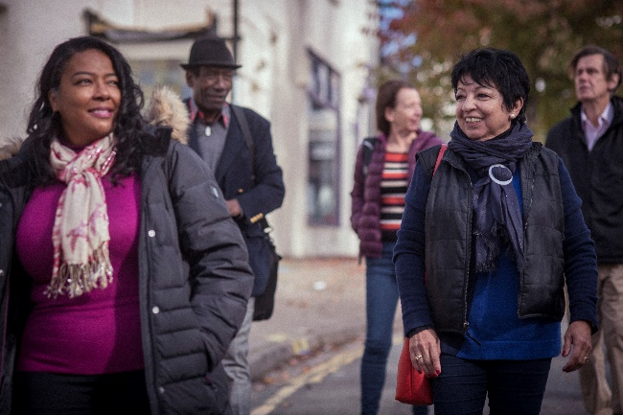
Why is it important that we work alongside experts by experience?
To make sure we are asking the right questions
To understand the lived experience of older people and ensure our research is responding to their needs
To check the way we are going to do the research is acceptable to older people taking part
To ensure the research findings reach the right people
To make sure the research we do is going to make a difference, to improve the lives of older people living in GM and beyond

Slide 12
How do we prioritise what research we do?
Linking to the Greater Manchester plan
Talking to different communities within GM
Engaging with the local health and social care system
Working with healthy ageing charities and organisations
Public engagement events – talking to people like yourselves

Slide 13
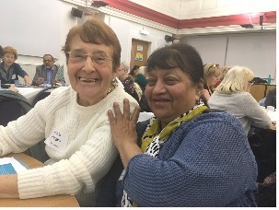
How to participate
Join the GM Older People’s Network
www.gmopn.org.uk
Join one of our working groups
Transport, Housing and Neighbourhoods, Health and Social Care

Slide 14
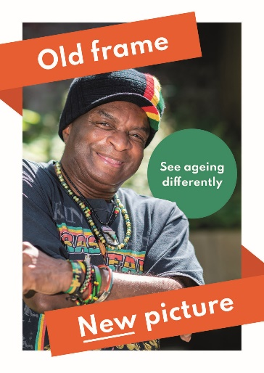
How to participate
New Group on Ageism and Representation of Older People (May – October)
Research Project on Housing Options Information for Older People (May – October)

Slide 15
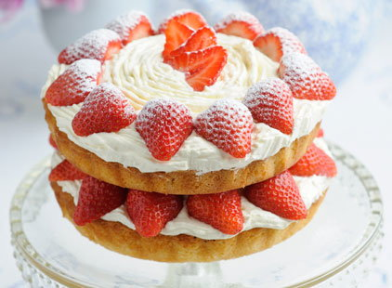
A research question - as cake!
Deciding we need cake
Choosing the right cake
Making sure we have the right ingredients
Knowing the baking method
Actually making the cake
Looking at the results
Presenting/decorating the cake
Sharing the cake

Slide 16
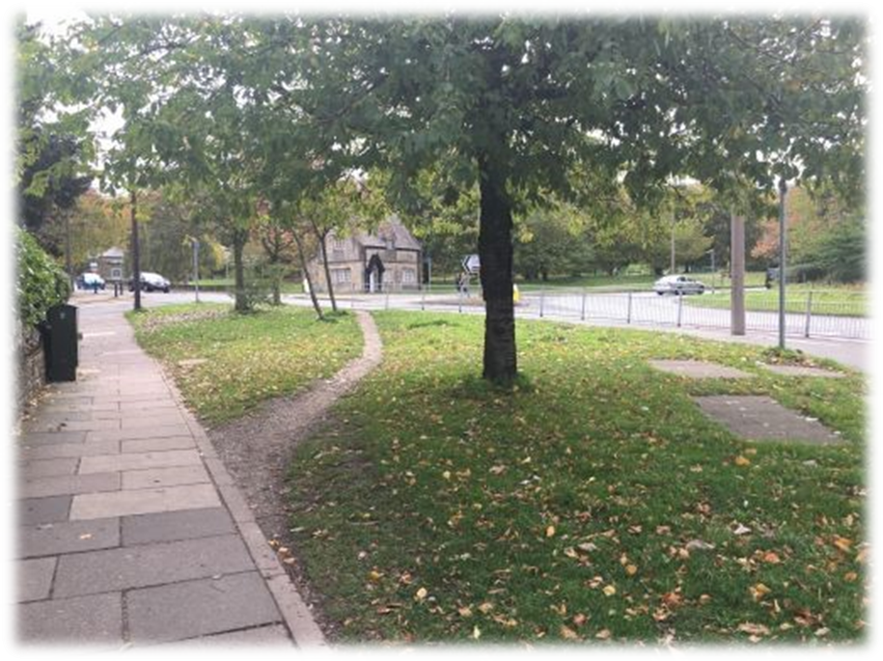
Ways to get involved in research
Defined as an active partnership between the public and researchers in the research process
Notes:
Developing project ideas
Advising on how to improve material for a projects
Giving your expert advice on what may work better when contacting people to get involved
Being part of a project team – attending and contributing at meetings, looking at research findings with the team
Spreading the word – helping get the research findings to the right people to ensure improvements to services are made

